Slide 1
Company Overview
January 12, 2025

Slide 2
Forward Looking Statement
The Presentation contains forward-looking statements within the meaning of the safe harbor provisions of the Private Securities Litigation Reform Act of 1995, as amended. Words such as ‘‘aim,’’ ‘‘anticipate,’’ ‘‘assume,’’ ‘‘believe,’’ ‘‘contemplate,’’ ‘‘continue,’’ ‘‘could,’’ ‘‘design,’’ ‘‘due,’’ ‘‘estimate,’’ ‘‘expect,’’ ‘‘goal,’’ ‘‘intend,’’ ‘‘may,’’ ‘‘objective,’’ ‘‘plan,’’ ‘‘predict,’’ ‘‘positioned,’’ ‘‘potential,’’ ‘‘project,’’ ‘‘seek,’’ ‘‘should,’’ ‘‘target,’’ ‘‘will,’’ ‘‘would’’ (as well as other words or expressions referencing future events, conditions or circumstances) are intended to identify forward-looking statements. These forward- looking statements are based on Milestone's expectations and assumptions as of the date of this Presentation. Each of these forward-looking statements involves risks and uncertainties. Actual results may differ materially from these forward-looking statements. Forward-looking statements contained in this Presentation include statements regarding (i) the design, progress, timing, scope and results of the etripamil clinical trials in PSVT and AFib-RVR, (ii) the potential efficacy, safety and tolerability of CARDAMYST for PSVT and etripamil for AFib-RVR, (iii) the potential of CARDAMYST to deliver a new PSVT therapeutic option to market, (iv) plans relating to commercializing CARDAMYST, if approved, including the geographic areas of focus and sales strategy, (v) the potential market size and the rate and degree of market acceptance of CARDAMYST (etripamil) and any future product candidates and the implementation of Milestone's business model and strategic plans for its business, etripamil and any future product candidates (vi) Milestone’s expected cash runway and (vii) potential royalty payments. Important factors that could cause actual results to differ materially from those in the forward-looking statements include, but are not limited to, the risks inherent in biopharmaceutical product development and clinical trials, including the lengthy and uncertain regulatory approval process, uncertainties as to whether our NDA filing for CARDAMYST will be approved by the FDA, uncertainties related to the timing of initiation, enrollment, completion and evaluation of clinical trials, including the RAPID and ReVeRA trials, and whether the clinical trials will validate the safety and efficacy of CARDAMYST for PSVT, etripamil for AFib-RVR or other indications, among others, as well as risks related to pandemics and public health emergencies, including those related to COVID-19, and risks related the sufficiency of our capital resources and our ability to raise additional capital. These and other risks are set forth in Milestone's filings with the U.S. Securities and Exchange Commission, including in its annual report on Form 10-K for the year ended December 31, 2023, under the caption "Risk Factors”, as such discussion may be updated in future filings we make with the SEC. Except as required by law, Milestone assumes no obligation to update any forward- looking statements contained herein to reflect any change in expectations, even as new information becomes available.
This Presentation contains trademarks, trade names and service marks of other companies, which are the property of their respective owners. Certain information contained in this Presentation and statements made orally during this Presentation relate to or is based on studies, publications, surveys and other data obtained from third-party sources and Milestone's own internal estimates and research. While Milestone believes these third-party studies, publications, surveys and other data to be reliable as of the date of the Presentation, it has not independently verified, and makes no representation as to the adequacy, fairness, accuracy or completeness of, any information obtained from third-party sources. In addition, no independent sources has evaluated the reasonableness or accuracy of Milestone's internal estimates or research and no reliance should be made on any information or statements made in this Presentation relating to or based on such internal estimates and research.
CARDAMYSTTM (etripamil) nasal spray is an investigational new drug, which is not approved for commercial distribution in the United States.

Slide 3
Milestone Pharmaceuticals: Aspiring to Give Patients Control over Common Heart Conditions
Empowering Patients
Self-Treat Common Arrhythmias
PSVT
Commercial Launch Preparation
AFib-RVR
Market Expansion Opportunity
CARDAMYSTTM (etripamil) nasal spray: investigational novel calcium channel blocker
Fast-acting, well-tolerated, portable, on-demand
Shift from Emergency Department to patient self-management
Successful Phase 3 -Published in The Lancet
NDA accepted May 2024, PDUFA action date Mar 27, 2025
Experienced leadership driving commercialization
Positive Phase 2 ReVeRA Study published in Circulation AE – Nov 2023
Anticipate Phase 3 study start - 1H2025
PSVT = Paroxysmal Supraventricular Tachycardia; AFib-RVR = Atrial Fibrillation with Rapid Ventricular Rate; NDA = New Drug Application; PDUFA = Prescription Drug User Fee Act. Citations: Stambler B et al, The Lancet (2023); Camm AJ et al, Circulation: Arrhythmia & Electrophysiology (2023)

Slide 4
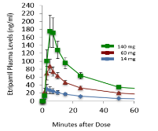
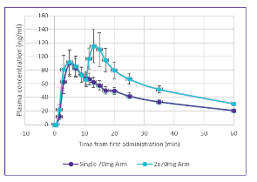
Etripamil Nasal Spray: A Novel CCB Designed to be Fast, Portable, ​and Patient-Empowering
PK Plots of Intranasally Administered Etripamil (single and repeat dosing)
Developed to rapidly terminate episodes of PSVT
Designed for patient self-administration where and whenever the episodes occur
Novel, investigational, L-type calcium channel blocker
Formulated as intranasal spray with:
Rapid onset of action (T_{max} ≤ 7 min)
Short-lasting duration: eliminated from blood within a few hours
Patent Protection until 2036
PSVT= paroxysmal supraventricular tachycardia; CCB=calcium channel blocker; PK = pharmacokinetic. Error bars = standard error (SE) of the mean.
Sources: Stambler BS, et al., J Am Coll Cardiol. 2018; Wight D, et al. J Am Coll Cardiol. 2022 Mar, 79 (9_Supplement); Ip JE, et al. manuscript in preparation. ; NODE-PK-101, -103, data on file.

Slide 5
Atrial Arrhythmias with a Common Patient Burden & Cardiac Target
Burden: Patients with PSVT & AFib-RVR report marked, often-disabling symptoms
Target: PSVT & AFib-RVR Rely on AV Nodal Properties
PSVT (AVNRT and AVRT) | AFib-RVR (a subset of AFib)
Regular rapid heart rate | Irregular rapid heart rate
Commonly 150 - 250 bpm | Commonly 100 - 175 bpm
Episode frequency and duration is highly variable; occurring without warning
Atrial Fibrillation (multiple atrial wavelets)
SA Node
AV Node
Common Symptoms Include | Heart palpitations Chest pressure or pain Shortness of breath Fatigue Light-headedness Anxiety / Loss-of-control
AV Nodal Reentrant Tachycardia (AVNRT)
AV Reentrant Tachycardia (AVRT)
PSVT = Paroxysmal Supraventricular Tachycardia; AFib-RVR = Atrial Fibrillation with Rapid Ventricular Rate.
Sources: adapted from https://en.ecgpedia.org/index.php?title=Supraventricular_Rhythms, accessed 2/2021

Slide 6
Current Treatment of Acute Attacks in the Emergency Department are Burdensome and Costly
For many patients, physicians, and payers:
Time-consuming, disruptive
Often results in a hospital admission
Expensive use of healthcare system resources
Need for simple, fast-acting treatment, reduce trips to ED and calls to physicians
ED = Emergency Department
Notes:
In the case of PSVT the standard of care for patients in the emergency department is ADENOSINE – which causes complete heart block ... Flat line for a short period of time – and is very frequently described by the patient as a very frightening experience. As a result of the poor options to teat these attacks in the moment … trip to the ED and then getting adenosine or potentially electrical cardio conversion … patients become very reluctant to go back on future episodes and often withdraw from the system to the poor options.

Slide 7
PSVT and AFib-RVR Populations in the US
 | PSVT | Atrial Fibrillation
Total Patients (2030) | 2.6 Million³ | 10 Million¹
Discharged ED Visits & Hospital Admissions (2016)² | 145 Thousand | 785 Thousand
Target Addressable Market (2030) Patient Population | 1.0-1.6 Million⁵ | ~3-4 Million⁴
PSVT = Paroxysmal Supraventricular Tachycardia; AFib-RVR = Atrial Fibrillation with Rapid Ventricular Rate.
Source(s): 1. Colilla et al., Am. J. Cardiol. 2013, 112(8), 1142-1147; Miyasaka et al., Circulation, 2006, 114, 119-125. American Heart Association 2. HCUP ED & Admissions Data (2016), accessed January 2021. 3. Rehorn et al. Journal of Cardiovascular Electrophysiology. 2021 Aug; 32(8): 2199-2206. doi: 10.1111/jce.15109. Epub 2021 Jun 14. 2018 prevalence of 2M anticipated to grow at a CAGR of ~2% 4. Quantitative Survey conducted by Triangle Insights, May 2021, N=250 Clinical Cardiologists, Interventional Cardiologists, and Electrophysiologists. 5. Estimate of TAM (~40%-60% of prevalence) based on internal PSVT patient market research (BluePrint Research Group, n=247) and longitudinal analysis of claims data.

Slide 8
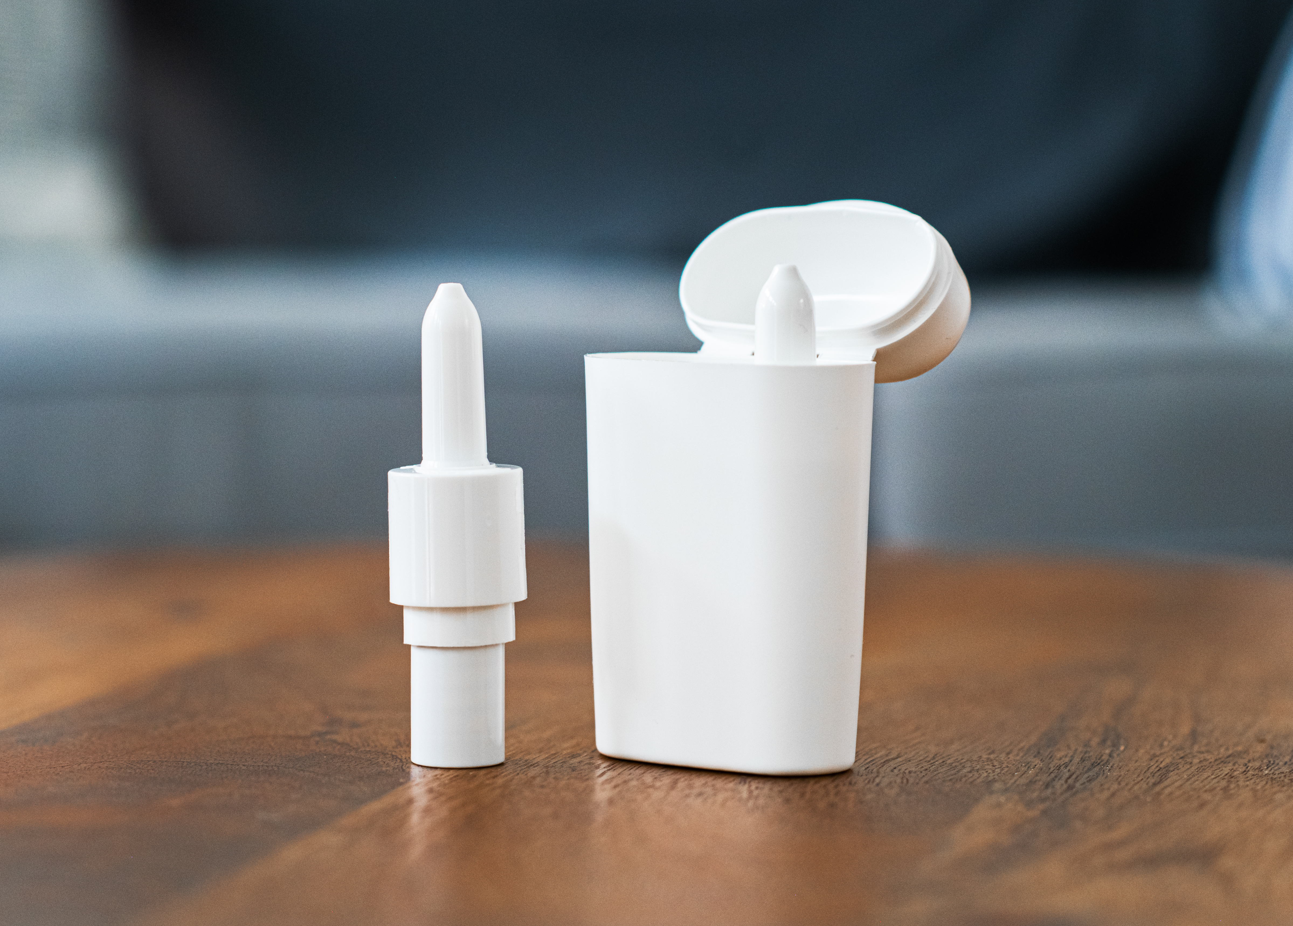
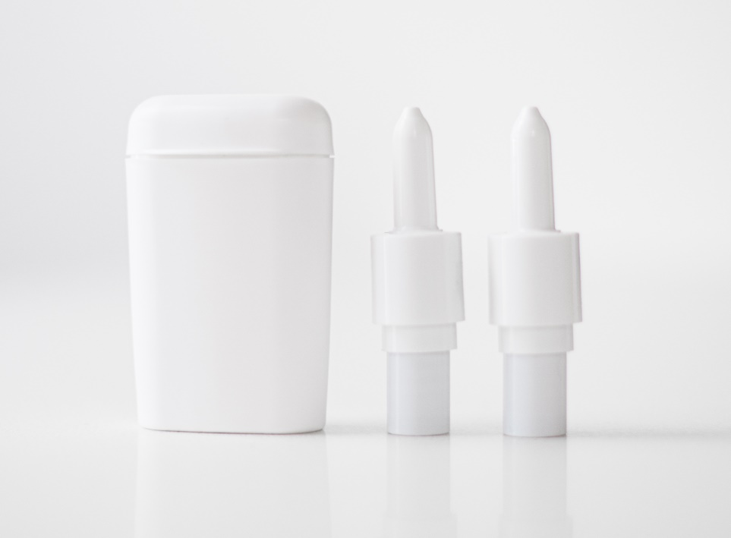
CARDAMYST is a Novel L-type Investigational Calcium Channel Blocker Designed to Treat Episodes Quickly
Fast onset of action (T_{max} ≤ 7 min)
Patient
self-administered
Small enough to fit in your pocket
Empowering patients to treat symptomatic attacks

Slide 9
Current US PSVT Market
Total annual US healthcare expenditures of ~$3B
Current Management
Prevalence ~2M patients diagnosed with PSVT
~650K patients treated per year
~300K newly diagnosed per year
>150K ED/hospital visits per year
~80K ablations per year
PSVT = Paroxysmal Supraventricular Tachycardia; ED = Emergency Department
Source: (1) Sacks, N.C. et al; Prevalence of Paroxysmal Supraventricular Tachycardia (PSVT) in the US in Patients Under 65 Years of Age; Abstract and Oral Presentation at the International Academy of Cardiology Annual Scientific Sessions 2018, 23rd World Congress on Heart Disease; Precision Xtract, Boston, MA, USA; and data-on-file from IBM Marketscan® Commercial Research Database (<65y) and the Medicare Limited Dataset (≥65y), with demographic, enrollment and claims data for commercially insured (Truven) and Medicare covered patients using PSVT code 427.0 or I47.1 for up to a 9-year interval between 2008 and 2016 inclusive; (2) Quantitative market research conducted by Triangle Insights Group (n=250 cardiologists), June-September 2020

Slide 10
Core PSVT Market is Addressable Now*, with Large Potential for Expansion
Initial Target Market
~650k/year³
Diagnosed, Annually Treated Patients
2.1 Million
~1.4 Million²
Diagnosed, Not Annually Treated Patients
Future Target Market
~600-900k¹
Undiagnosed Patients
*if approved
Sources: 1) assumes annual incidence rate for PSVT of ~300k from longitudinal claims analysis and the average time to diagnosis (currently 2-3 years) can be reduced to <6 months 2) Calculated as the difference between PSVT prevalence of 2.1M and annual treatment rate of ~650k from Truven MarketScan data, 2008-2016 analyzed by Precision Xtract, 2019 3) Estimated number of unique patients with annual claims for PSVT from Truven MarketScan data, 2008-2016 analyzed by Precision Xtract, 2019.

Slide 11
CARDAMYST Has Substantial Potential Value for Stakeholder Groups If Approved
Physicians –
Dependable Tool
Payers – More Efficient Use of Resources
Patients - Empowerment
Fast, reliable self-administration
Less disruption, reliance on the Emergency Department
Less fear over when the next event will occur
Designed for patient self-management
Frees up physician time and office resources
Trusted CCB mechanism
Novel and cost-effective treatment
Reduction in ED/hospital admissions
Sources: Internal market research, PSVT = Paroxysmal Supraventricular Tachycardia, CCB = Calcium Channel Blocker, ED = Emergency Department.

Slide 12
Cardiologists Expect to Prescribe CARDAMYST to the Majority of Unablated Patients with PSVT
Current
PSVT Management
Cardiologists’ Stated Adoption of CARDAMYST per Segment
Impact of Cardiologist Adoption of CARDAMYST
Pill-in-Pocket (PIP) 64%
Chronic Meds Alone 43%
No Current Treatment 53%
Source: Quantitative market research conducted by Triangle Insights Group (n=250 cardiologists), June-September 2020; Estimated number of unique patients with annual claims for PSVT from Truven MarketScan data, 2008-2016 analyzed by Precision Xtract, 2019

Slide 13
Management of Patients with PSVT and Call Point Targeting
 |  | Clinical Cardiologists | Primary Care Physicians | Electro-physiologists
% of patients managed |  | ~60% | ~30% | ~10%
Long-term Use | Add to or Replace Chronic Medications
Medium-term Use | Defer Ablation
Short-term Use | Bridge to Ablation
Primary Target
Secondary Target
Targeted sales force to reach majority of available opportunity
Significant overlap with most common CV portfolio call points
Majority of patients with PSVT managed by CV specialists, leading to commercial efficiencies
Source: Internal market research
Notes:
Targeted call point that

Slide 14
Peak US Market Opportunity for CARDAMYST in PSVT
Patients with PSVT
US Prevalence (2030)
~ 2.6 million patients¹
~60%
with multiple 10+ minute moderate/severe* episodes per year
~40-60%²
Addressable Market (2030)
~1.0-1.6 million patients
~45%
Experience an average duration ≥30 min / episode
50%³
Peak Share
~500-800K patients
Episodes of PSVT
12-15
median annual episode frequency
Episodes Treated/Pt
~4-6 / year
Avg of 5 / yr
60%
last at least 10 minutes
Episodes/Yr
~2.5 to 4.0 million episodes/yr
35%
last at least 30 minutes
Peak Net Sales
*Patient stated severity of SVT episode (mild, moderate, or severe)
Sources: Internal estimates based on market and outcomes research, Milestone Pharmaceuticals. 1. Rehorn et al. Journal of Cardiovascular Electrophysiology. 2021 Aug; 32(8): 2199-2206. doi: 10.1111/jce.15109. Epub 2021 Jun 14. 2. 2019 market research with patients conducted by BluePrint Research Group (n=247) . 3. 2020 market research with HCPs conducted by Triangle Insights Group, 2020 (n=250).
Notes:
Our first analysis of the data set enabled us to gain important insights into some of the key assumptions behind our estimate of the market opportunity for etripamil, which is shown here.
This slide shows our updated understanding of the etripamil peak US market opportunity for PSVT in the US
We start by providing prevalence estimates projected for 2030 as more relevant that the prior reported 2016 figures, as we feel 2030 more closely aligns with potential timing for etripamil peak year penetration
From there, we re-affirm our believe that between 40-60% of the prevalent population patients experience PSVT episodes that are both long enough and bothersome enough to be candidates for etripamil use.
We feel the confirmation of the same (40-60%) figures previously reported but now supported by the analysis from the patient longitudinal study provides us increased confidence in the peak target addressable market for etripamil, which we estimate to be between 1 and 1.6M patients.
Following through on the cascade, we estimate based on physician market research peak year share utilization of approximately 50%, yielding between 500-800k patients treated with etripamil in peak year.
The next assumption that was further elucidated by the PRO longitudinal study is the number of events that patients experience that would warrant etripamil use.
The PRO study revealed that patients in study reported a median range of 12-15 events per year, which was approximately twice as much as we had originally understood from traditional market research. Additionally, approximately 60% were events lasting at least 10 minutes, which is a marker of duration we utilize for etripamil potential utilization and that 35% of episodes lasted at least 30 minutes.
We model an average of 5 utilizations of etripamil per patient per year based on the most recent learnings.
Applying the math – results in our estimating between 2.5-4M utilizations of etripamil in the peak year peak.
The increased volume expectations stemming from this updated analysis provides for potential increased upside in peak year net sales revues as well a for increased flexibility on pricing as we move to a final target product profile as we complete the remainder of the phase 3 development program for PSVT.

Slide 15
Peak US Market Opportunity for CARDAMYST in PSVT and AFib-RVR
PSVT
AFib-RVR
~2.6 million patients¹
US Prevalence (2030)
~10 million patients
~40-60%²
~30-40%
~1.0-1.6 million patients
Addressable Market
~3-4 million patients
~50%³
~500k-800k patients
Peak Share
4-6/year
Episodes/Pt
Avg of 5 / yr²
~2.5-4.0 million episodes/year
Episodes/Yr
2030 Peak Net Sales
PSVT = Paroxysmal Supraventricular Tachycardia; AFib – RVR = Atrial Fibrillation with Rapid Ventricular Rate; TAM = Target Addressable Market
Market Research Suggests a TAM of 4+ Million Patients across both PSVT and AFib-RVR Indications
Sources: 1. Rehorn et al. Journal of Cardiovascular Electrophysiology. 2021 Aug; 32(8): 2199-2206. doi: 10.1111/jce.15109. ; 2. 2019 market research with patients conducted by BluePrint Research Group, ( n=247); 3. 2020 market research with healthcare providers conducted by Triangle Insights Group, (n=250)

Slide 16
Clinical Pipeline Advancement for Etripamil
Pharmacology of L-type calcium channel blockers drives broad clinical utility
Phase 1
Phase 2
Phase 3
NDA Filing / Approval
PSVT
Rapid conversion to sinus rhythm
AFib-RVR
Acute control of rapid
ventricular rate
PSVT = Paroxysmal Supraventricular Tachycardia; AFib-RVR = Atrial Fibrillation with Rapid Ventricular Rate; NDA = New Drug Application

Slide 17
Comprehensive Data Supports FDA New Drug Application for Rapid Conversion of SVT Episodes to Sinus Rhythm in Adults
NODE-1 | NODE-301 | NODE-302 (Ext. of NODE-301) | RAPID | NODE-303
Phase 2 | Phase 3 | Phase 3 | Phase 3 | Phase 3
Efficacy (dose finding) | Efficacy | Safety & Efficacy (Repeat Episodes) | Efficacy | Safety (Repeat Episodes)
N = 64 | N = 431 | N = 169 | N=706 | N = 503
>1,600 Patient Exposures to Etripamil ≥ 70 mg
Positive Phase 3 pivotal RAPID trial anchors NDA submission
NDA = New Drug Application; SVT = Supraventricular Tachycardia
NB: NODE-301 and RAPID studies also collected Safety information
Source: Milestone Pharmaceuticals Data on File

Slide 18
Positive Phase 3 RAPID Trial in Patients with PSVT
Randomized, double-blind, placebo-controlled trial enrolled 706 patients to self-administer etripamil NS 70 mg regimen or placebo NS during a PSVT event outside the medical setting
Repeat-dose regimen – if symptoms not resolved in 10 minutes, second dose administered
Achieved primary endpoint - statistical significance (HR = 2.62; 95% CI 1.66, 4.15; p<0.001)
Median time to conversion 17.2 min with etripamil vs. 53.5 min with placebo
Need for additional medical interventions or emergency department care ~40% lower for etripamil patients compared to placebo
Favorable safety and tolerability consistent with prior studies – the most common AEs localized to nasal administration site
Primary: Conversion of Adjudicated PSVT to Normal Sinus Rhythm (NSR) at 30 min
NS= nasal spray; HR = Hazard Ratio; CI = Confidence Interval. Median Time To Conversion data: 17.2 min (95% CI 13.4, 26.5) with etripamil nasal spray regimen vs. 53.5 min (95% CI 38.7, 87.3) with placebo. Source: American Heart Association Scientific Sessions, Late-Breaking Clinical Trial Presentation, November 2022; Am Heart J (2022); and The Lancet (2023).

Slide 19
Data Indicate Fast Conversion to Normal Sinus Rhythm (NSR) RAPID Study
Conversion of Adjudicated PSVT to NSR at 30 min HR = 2.62 (95% CI, 1.659-4.147); p<0.001
81%
Etripamil
64%
73%
61%
55%
Placebo
31%
Number of Subjects at Risk
Placebo
85
78
67
64
60
58
56
53
49
45
44
40
37
37
36
36
35
35
32
"+" symbol on graph indicates censoring for signal loss (n=4 over 90 minutes)
Source: Milestone Pharmaceuticals Data on File
Etripamil
99
79
67
55
45
40
35
33
31
29
28
27
26
25
23
22
20
19
19
HR = Hazard Ratio; CI = Confidence Interval. Source: American Heart Association Scientific Sessions, Late-Breaking Clinical Trial Presentation, November 2022; and The Lancet (2023).

Slide 20
Fewer Medical Interventions and Emergency Department Visits RAPID & NODE-301 Studies
Placebo
Etripamil
Patients Receiving Medical Intervention
Patients with Emergency Department Visits
P=0.0587
P=0.103
P=0.013
P=0.076
P=0.209
P=0.035
43%
39%
n=13
n=15
n=21
n=15
n=34
n=30
n=12
n=14
n=18
n=14
n=30
n=28
n=49
n=107
n=85
n=99
n=134
n=206
n=49
n=107
n=85
n=99
n=134
n=206
Pooling of data and analyses were prespecified in RAPID statistical analysis plan. Statistical analyses performed by Chi-square test for each study data set and pooled data set. Sources: American Heart Association Scientific Sessions, Late-Breaking Clinical Trial Presentation (Nov. 2022); International Society for Pharmacoeconomics and Outcomes Research (ISPOR) Presentation (May 2023)

Slide 21
CARDAMYST Well-Tolerated with a Favorable Safety Profile RAPID Study – Safety Events
Subject-reported AEs,¹ n (%) | Placebo² N=120 | Etripamil² N=135
Nasal discomfort | 6 (5.0) | 31 (23.0)
Nasal congestion | 1 (0.8) | 17 (12.6)
Rhinorrhea | 3 (2.5) | 12 (8.9)
Epistaxis | 2 (1.7) | 8 (5.9)³
Syncope | 0.0 | 0.0
Loss of Consciousness | 0.0 | 0.0
Pre-Syncope | 0.0 | 0.0
Dizziness | 0.0 | 1 (0.7)⁴
Subjects with Events from Independent ECG Reading,⁵ n (%) | Placebo⁶ N=116 | Etripamil⁶ N=128
2nd Degree AV Block - Mobitz I AV Block | 0 | 0
2nd Degree AV Block - Mobitz II AV Block | 0 | 0
3rd Degree AV Block | 0 | 0
¹ Randomized-period treatment-emergent adverse events, those ≥5% or those specifically tracked as potentially representing lowered blood pressure. ² Safety Population. ³ Six of 8 rated as mild, 2 of 8 rated as moderate, 0 needing intervention. ⁴ Rated as mild. ⁵Expert cardiac electrophysiologist adjudication committee. ⁶Safety population with evaluable 5-hr. ambulatory ECG data. AE timing – within 24 hours following drug administration. Source: American Heart Association Scientific Sessions, Late-Breaking Clinical Trial Presentation, November 2022; and The Lancet (2023).

Slide 22
PSVT & AFib-RVR Populations in the US
Atrial Fibrillation
10 Million¹
785 Thousand
AFib-RVR ~3-4 Million⁴
 | PSVT | Atrial Fibrillation
Total Patients (2030) | 2.6 Million³ | 10 Million¹
Discharged ED Visits & Hospital Admissions (2016)² | 145 Thousand | 785 Thousand
Target Addressable Market (2030) Patient Population | 1.0-1.6 Million⁵ | ~3-4 Million⁴
Source(s): 1. Colilla et al., Am. J. Cardiol. 2013, 112(8), 1142-1147; Miyasaka et al., Circulation, 2006, 114, 119-125. American Heart Association 2. HCUP ED & Admissions Data (2016), accessed January 2021. 3. Rehorn et al. Journal of Cardiovascular Electrophysiology. 2021 Aug; 32(8): 2199-2206. doi: 10.1111/jce.15109. Epub 2021 Jun 14. 2018 prevalence of 2M anticipated to grow at a CAGR of ~2% 4. Quantitative Survey conducted by Triangle Insights, May 2021, N=250 Clinical Cardiologists, Interventional Cardiologists, and Electrophysiologists. 5. Estimate of TAM (~40%-60% of prevalence) based 2019 market research with patients conducted by BluePrint Research Group, ( n=247)

Slide 23
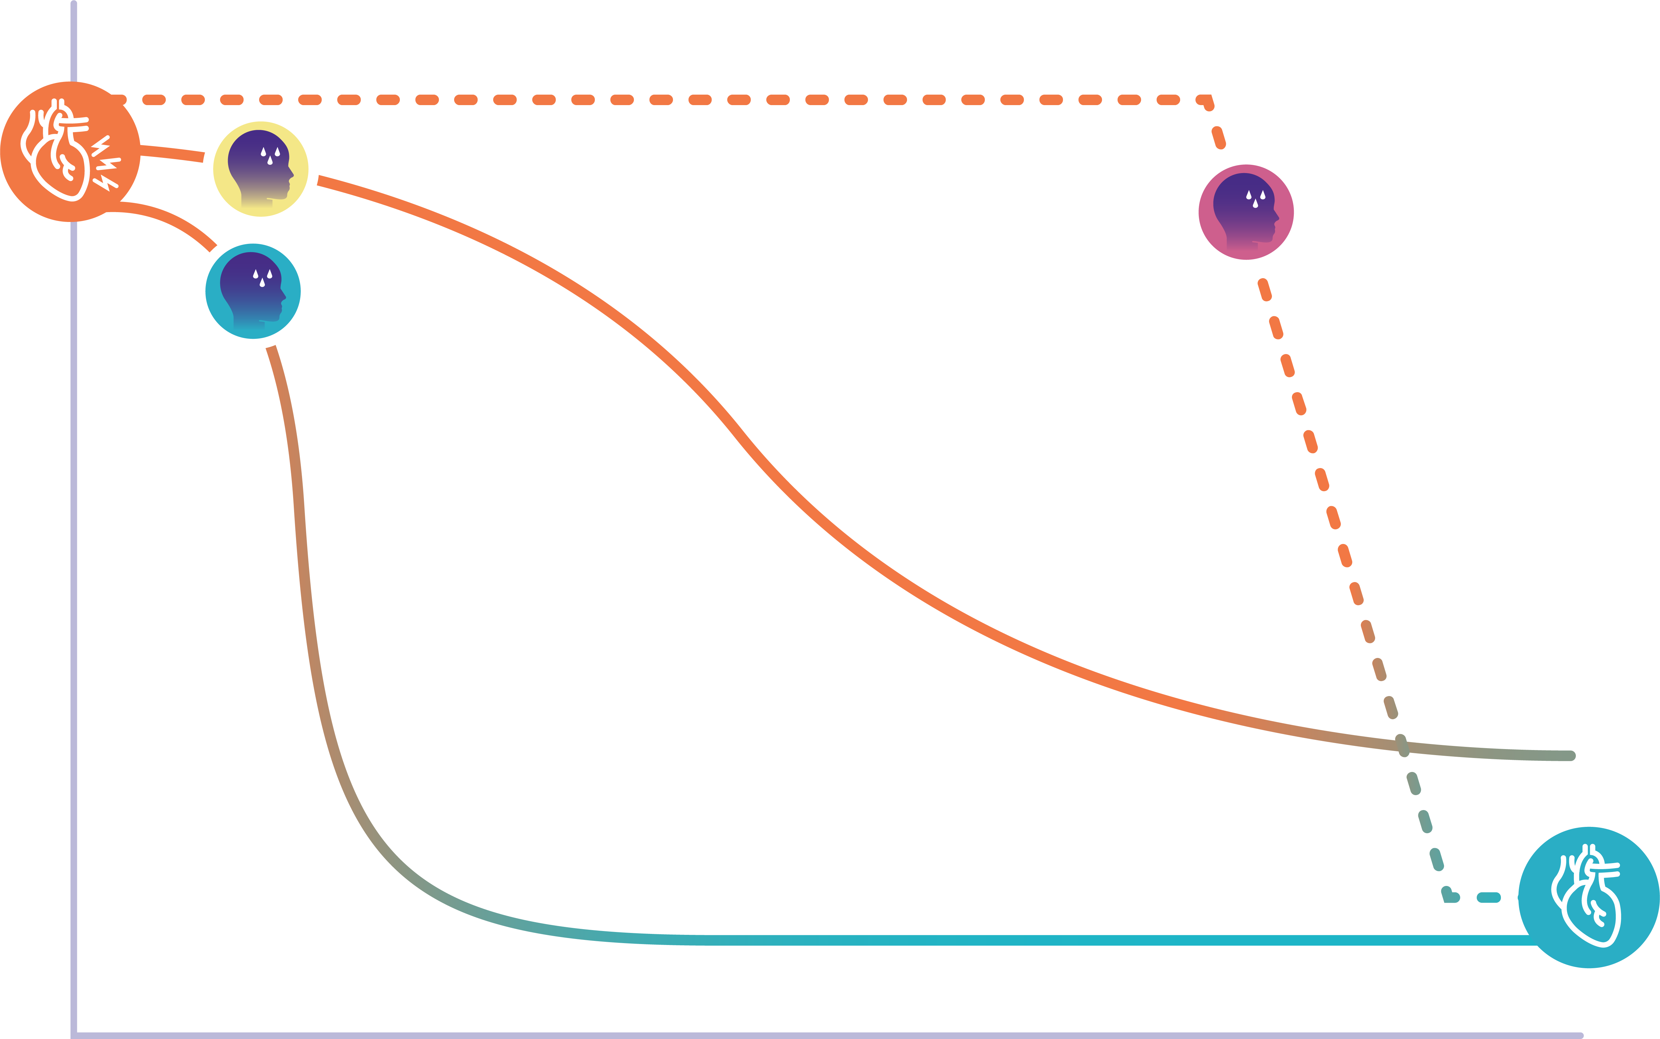
AFib-RVR – Acute Treatment Scenarios
Acute AFib-RVR Attack
Patient 2:
Oral drug (SOC)
Patient 1: Emergency Department, intravenous drug
Patient 3:
Self-administered, fast-acting Rx
Heart Rate
Heart palpitations
Chest pressure or pain
Shortness of breath
Fatigue
Light-headedness
Anxiety
Time (hrs)

Slide 24
Potential Use Cases of Etripamil for AFib-RVR
Acute, stand-alone, portable treatment for rate control and symptom control
Acute treatment as a bridge (“precursor”) to the delayed effects of oral rate-control or anti-arrhythmic drug administration
Use peri-ablation
Non-invasive administration opens options for potential treatment without an IV line in emergency-department or ambulance setting
AFib-RVR = atrial fibrillation with rapid ventricular rate, Rx = treatment, IV = intravenous
A drug that is rapidly acting and self-administered outside of a medical setting
could have characteristics that fulfill an unmet medical need

Slide 25
ReVeRA - Phase 2 Proof of Concept Trial of Etripamil in AFib-RVR in the Emergency Department Setting
Patient presents to ED with episode of AFib-RVR
Dosing & Assessment
Efficacy Analysis
1
2
3
Key Inclusion:
Atrial Fibrillation with Ventricular Rate (VR) ≥110 bpm
Paroxysmal, persistent, or permanent
Select Exclusion:
Treated with IV antiarrhythmic drugs within 1 h
Hemodynamically unstable
Severe heart failure
History of 2nd or 3rd degree AV block
Baseline ECG for ≥ 10 min
Administer double blind study drug 70 mg etripamil : Placebo (1:1)
Monitor in-patient for 1 hour
Six-hour remote cardiac monitor
Complete safety 24 hours post dose
Primary: Maximum reduction in VR within 60 min
N=50: 90% powered to detect 20 bpm difference in max reduction, α=0.05
Time to VR reduction
Duration of VR reductions
<100 bpm, ≥ 10% reduction, ≥ 20% reduction
Patient satisfaction with treatment (TSQM-9)
AFib-RVR = Atrial Fibrillation with Rapid Ventricular Rate; TSQM-9, Treatment Satisfaction Questionnaire for Medication; ED = Emergency Department. Source: American Heart Association Scientific Sessions, Featured Science Presentation, Nov. 2023; and Circulation: Arrhythmia & EP (Nov. 2023)
Assessing Ventricular Rate Reduction with Etripamil – How Much; How Fast; How Long

Slide 26
ReVeRA – Substantial & Rapid Reduction in VR with Etripamil
Primary Endpoint: Maximum Reduction in VR from Baseline | Placebo NS, N=25¹ | Etripamil NS (70 mg) N=24¹
Mean, bpm | -5.06 | -34.97
Difference in means, bpm | -- | -29.91
p-value² | -- | <0.0001
NS = Nasal Spray; VR = ventricular rate; bpm = beats per minute
Note: Data plotted on time course are not those directly used for calculation of Primary Endpoint (by pre-specified plan). X-axis: of plot: time following drug administration; Y-axis: 5-min moving average, bpm ±SEM. ¹ Efficacy Population (all randomized patients receiving study drug remaining in atrial fibrillation with adequately diagnostic ECG recordings for at least 60 min post drug) ² By ANCOVA. Source: American Heart Association Scientific Sessions, Featured Science Presentation, Nov. 2023; and Circulation: Arrhythmia & EP (Nov. 2023)

Slide 27
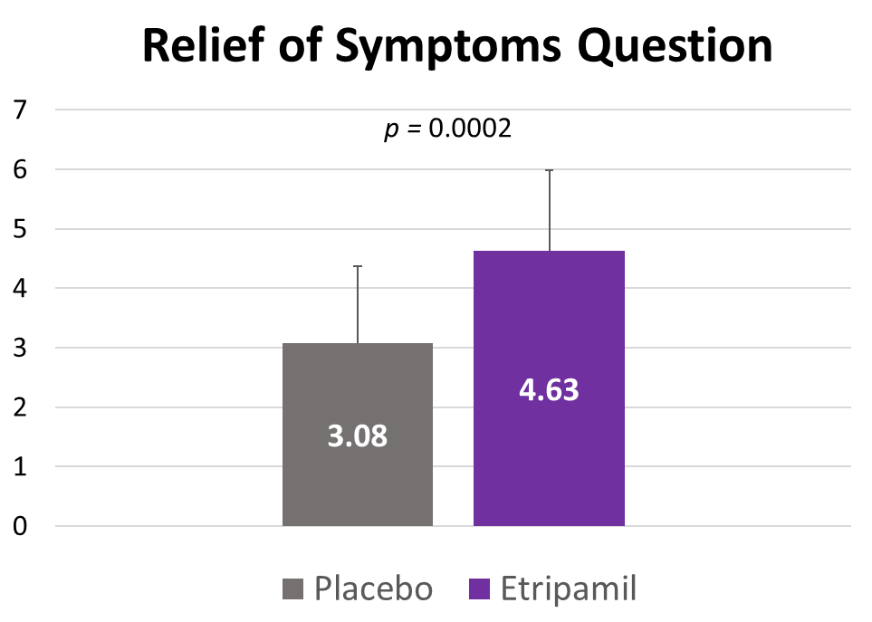
ReVeRA Study: TSQM-9 PRO¹ Assessment & Results
ReVeRA Data Show Significant Improvement in Patient-Reported Relief of Symptoms
TSQM-9 PRO¹ includes an Effectiveness Domain
Domain includes three questions, each answered on 7-point anchored scale
The domain score is calculated from its three question scores
Domain score is on a 0 to 100-point scale
Domain score of 50/100 corresponds to a 4/7 = “Somewhat Satisfied”
1 | 2 | 3 | 4 | 5 | 6 | 7
Extremely Dissatisfied | Very Dissatisfied | Dissatisfied | Somewhat Satisfied | Satisfied | Very Satisfied | Extremely Satisfied
 | Placebo² N=25 | Etripamil² N=24 | p value³
Effectiveness Domain Scores, mean (SD) | 36.67 (21.64) | 62.69 (21.59) | p<0.0001
Delta = 1.55 units on Relief of Symptoms
¹ Treatment Satisfaction Questionnaire for Medication-9, a validated Patient-Reported Outcome tool. ² Efficacy Population (all randomized patients receiving study drug remaining in atrial fibrillation with adequately diagnostic ECG recordings for at least 60 min post drug). ³ From t-test. Source: American Heart Association Scientific Sessions, Featured Science Presentation, Nov. 2023; and Circulation: Arrhythmia & EP (Nov. 2023)

Slide 28
Proposed Phase 3 Registrational Study in AFib-RVR
Key Inclusion Criterion: history of symptomatic episodes of AFib-RVR
Patients self-administer drug at-home for perceived episodes of AFib-RVR
Same clinical trial and etripamil treatment approach as used in PSVT program
Dose: etripamil 70 mg repeat-dose regimen (same as proposed indication in PSVT)
Primary endpoint = maximum reduction in VR, same as ReVeRA; etripamil vs placebo
Key Secondary endpoint = symptom relief, via PRO
Estimated study size: N ≈ 150-200 total events, based on: 90% power, p < 0.05
AFib-RVR = atrial fibrillation with rapid ventricular rate; PSVT = paroxysmal supraventricular tachycardia; VR=ventricular rate; PRO = patient reported outcome.

Slide 29
Financials as of September 30, 2024
Pro-forma cash and short-term investments of $76.4M
Funds operations into 2026
Synthetic Royalty Financing of $75M available upon approval⁽¹⁾
Launch funded for 4+ quarters
Pro-Forma Equity: 66.2M in shares & prefunded warrants
53.3M common shares
12.9M pre-funded warrants
In March 2023, Milestone announced a $125.0M strategic with RTW Investments. The financings consists of $50.0M in convertible notes issued in March 2023, and a commitment $75.0M in non-dilutive royalty funding if etripamil is approved by the FDA.

Slide 30
Milestone Pharmaceuticals: Aspiring to Give Patients Control over Common Heart Conditions
Empowering Patients
Self-Treat Common Arrhythmias
PSVT
Commercial Launch Preparation
AFib-RVR
Market Expansion Opportunity
CARDAMYSTTM (etripamil) nasal spray: investigational novel calcium channel blocker
Fast-acting, well-tolerated, portable, on-demand
Shift from Emergency Department to patient self-management
Successful Phase 3 -Published in The Lancet
NDA accepted May 2024, PDUFA action date Mar 27, 2025
Experienced leadership driving commercialization
Positive Phase 2 ReVeRA Study published in Circulation AE – Nov 2023
Anticipate Phase 3 study start - 1H2025
PSVT = Paroxysmal Supraventricular Tachycardia; AFib-RVR = Atrial Fibrillation with Rapid Ventricular Rate; NDA = New Drug Application; PDUFA = Prescription Drug User Fee Act. Citations: Stambler B et al, The Lancet (2023); Camm AJ et al, Circulation: Arrhythmia & Electrophysiology (2023)

Slide 31
Thank you

Slide 32
Strategic Financing with RTW Funds launch and commercialization of CARDAMYST in PSVT
$50M
Convertible Notes
$75M
Synthetic Royalty
6-year term
Initial Conversion Price $5.23/share
50% premium to 30-day VWAP¹
6% coupon
Payable quarterly, or at our option payable in kind (PIK) for first 3 years
Funded if FDA approves etripamil in PSVT
Non-dilutive synthetic royalty
7% Royalty² <$500M³
4% Royalty $500-$800M
1% Royalty >$800M
¹ VWAP – Volume Weighted Average Price as of 3/27/23 ² Rate can increase by 2.5% if certain annual net sales thresholds are not met ³ Annual net product sales of etripamil in the United States

Slide 33
NDA Resubmitted for CARDAMYST in PSVT
NDA Resubmission – March 2024
Expect standard NDA review period following resubmission
Resubmission included:
Supplementary datasets using slightly different method to define "treatment-emergent AEs”
ECG data files in additional formats to better enable FDA analyses
Type A meeting with FDA – February 2024
Timing of AEs in question had minimal impact on the overall characterization of the safety profile of CARDAMYST
Confirmation of approach to address RTF
RTF Notice – December 2023
FDA requested clarification about the times recorded for some AEs in the Phase 3 clinical trials
NDA = New Drug Application; PSVT = Paroxysmal Supraventricular Tachycardia; AEs = adverse events; ECG = electrocardiogram; RTF = Refusal to File.

